Slide 3


Slide 4
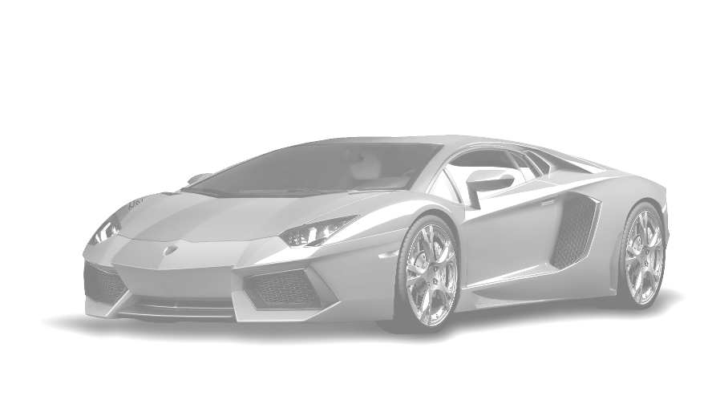
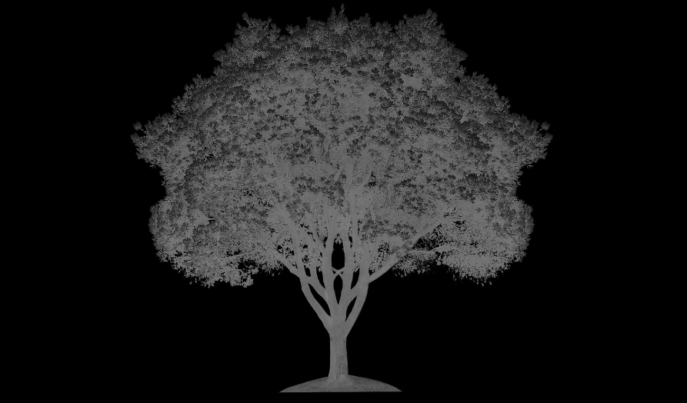

Slide 5
Colors
Swap
Input1
Invert
Select
Invert BG
Input2
Invert
Select
Invert BG
Generate
Save

Slide 6


Slide 7

